Slide 1
Back Propagation of Errors in Neural Network MS 7335: Machine Learning II
Paritosh Rai
ID: 47998747
SUPERVISED BY: Prof. John Santerre
Link vimeo: https://vimeo.com/528110559
Link YouTube: https://youtu.be/F_GhGYNx7WM

Slide 2

Agenda
What is Back Propagation
Neural Network Architecture
Training Neural Network
Activation Function
Forward and Backward Propagation
Multi Layer Neural Network
Chain Rule
Optimizer
Python Run

Slide 3
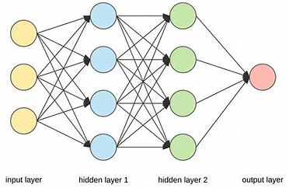
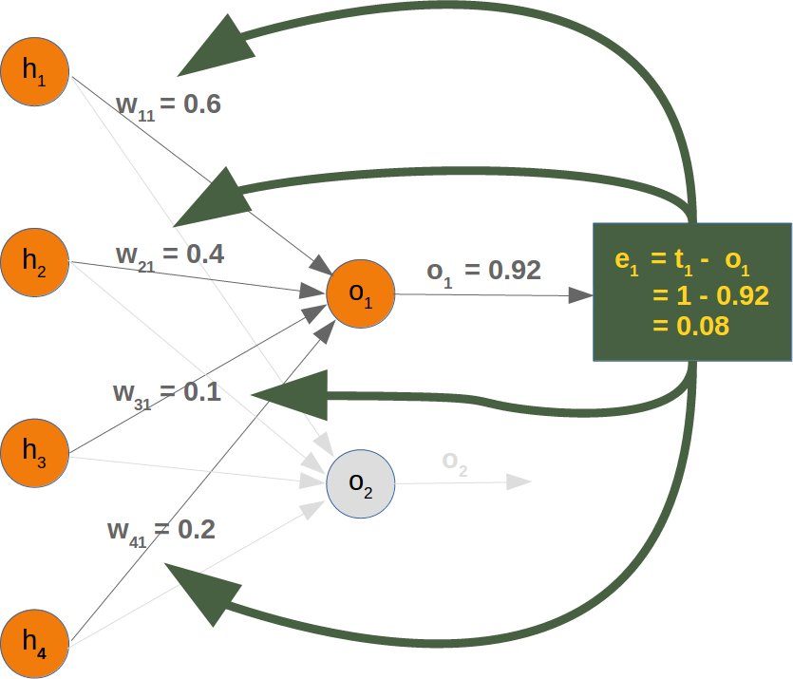
What is Back Propagation
Back propagation is an abbreviation for “backward propagation of errors”.
This method is used to train artificial neural networks.
This method calculates the gradient of a loss function with respect to all the weights in the network.
The gradient is fed to the optimizer to tune the weights to minimize the loss function.

Slide 4
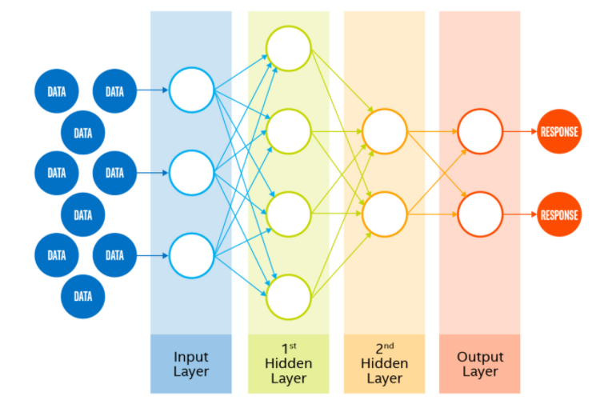
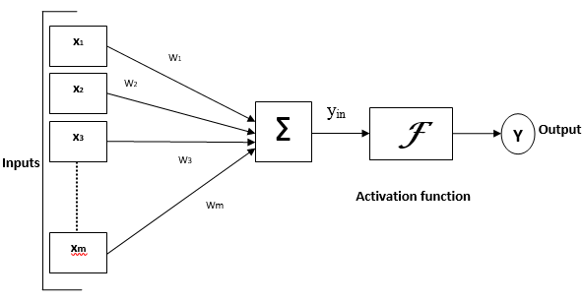

Neural Network Architecture
Multi-Layer Artificial Neural Network (ANN)
Neural Network is a computer model of the brain created by connecting computing nodes (neuron) in parallel to enhance the computational power to perform pattern/image recognition, classification, and data clustering
Increase in number of hidden layers increases computational complexity of the network
Nodes are connected in some pattern. Each link is associated with weight to excite or inhibit the signal between nodes. A neuron may have special weight call bias (b)
Simplified Artificial Neural Network
Each node has an internal state called an activation signal to process the input and produce an output.
Output of each node is produced after combining the input signal and activation signal.
y_{in} = x₁.w₁+ x₂w₂……..x_{m}.w_{m} => input with weight
y_{in} =∑^{m}_{i =}x_{i}.w_{i} => Summation of input with weight
Y = F(y_{in}) => apply activation function

Slide 5
Training Neural Network
Initialize network with random weights
Process the input through the network (input + weight + activation function)
Compare the output with a target output (calculate error)
Adjust the weights in the layer
Repeat steps 1 through 4 to minimize error (or error stops improving)
Learning
Use feed forward for learning weight
Use Gradient Descent to minimize the error – backward from output to hidden layer to input
Forward
Backward
Minimize Error

Slide 6
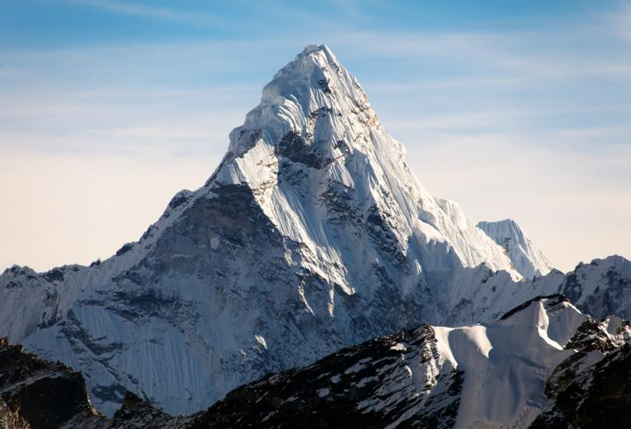
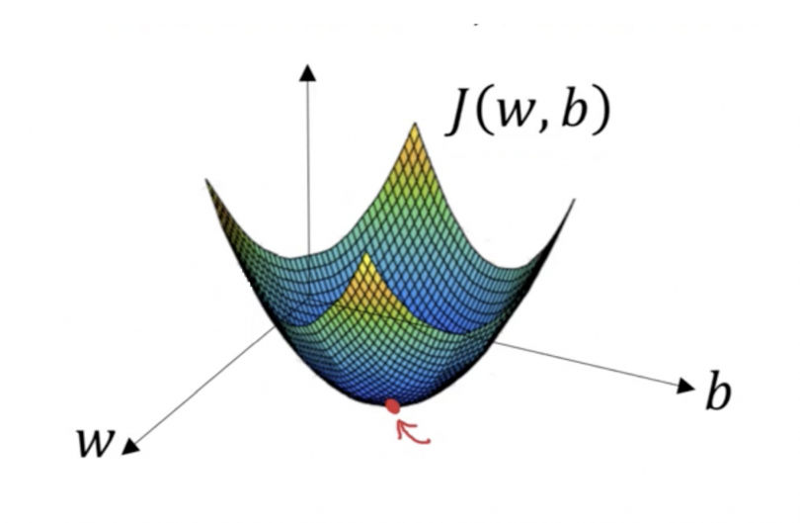
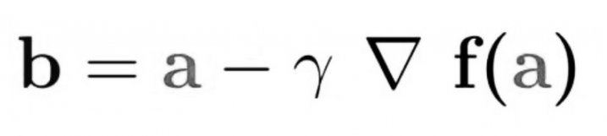
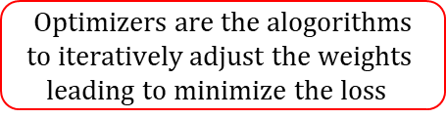
Gradient Descent (Optimizer)
Gradient Descent is the most popular optimization algorithm used in machine learning and deep learning. It is based on a convex function and tweaks its parameter iteratively to minimize the cost function.
A Gradient measures the change in weights with respect to change in error. Mathematically, Gradient is a partial derivative with respect to the inputs.
$$Optimizers are the alogorithms$$
$$to iteratively adjust the weights$$
$$leading to minimize the loss$$
In the above equation, b is the next value, a is the present value, γ is the weighting factor, and ▼f(a) is the direction of steepest descent.
Reach minimum/cost/error j(w,b) adjusting weight(w) and bias(b)

Slide 7
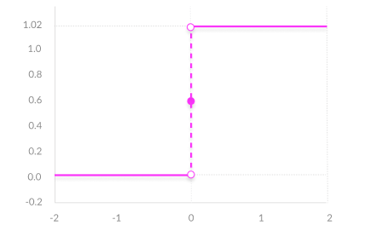
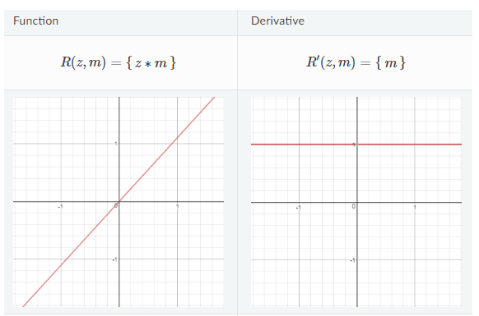
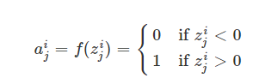
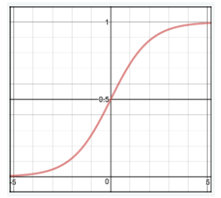
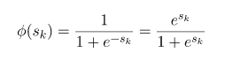
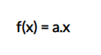
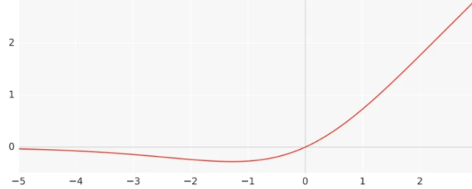
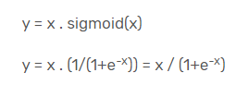
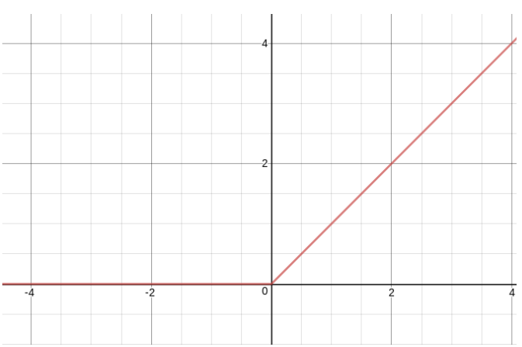
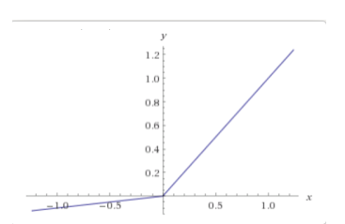
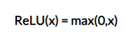
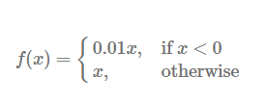
Activation Function in Neural Network
Activation functions are mathematical equations that determine the output of a neural network model.
Activation functions impact the convergence speed
Normalize the output in range of +1 to -1 or 0 to +1
Should be efficient and should reduce compactional cost
Binary Step Function: Thresholds the input values to 1 and 0, if they are greater or less than zero, respectively
Linear Activation Function: Provides a convex error surface so optimization can be achieved faster
Sigmoid Activation Function: bounded, differentiable, and nonnegative derivative.
This has a vanishing gradient, i.e., for deep NN error becomes very little during backward propagation that effect becomes negligible close to input.
Rectified Linear Units (ReLU): This over comes the vanishing gradient problem. This model learns faster and performs better.
For a negative input, the output is zero, and for positive it is x.
Swish Function: This was developed by Google. It has superior performance with same level of computational efficiency as ReLU.
Leaky ReLU: Learning rate is too high and has large negative bias. Helps with dying ReLU problem (i.e., when data has too many zero correction becomes difficult).

Slide 8
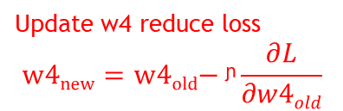
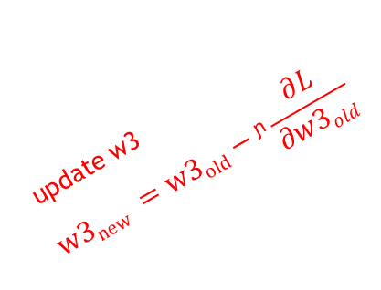
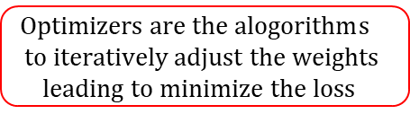
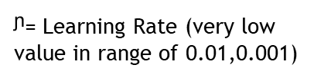
Forward and Backward Propagation
x1
Update w4 reduce loss
$$w4new=\text{w}\text{4}\text{old}\text{− }\text{ᶮ}\frac{∂L}{∂w4old}$$
update w1
Minimize the Loss
Loss(L) = ∑(y-ŷ)²
w1
Predicted Output (ŷ)
x2
w2
w4
Compare Actual and Predicted outputs (Loss)
f(∑xiwi)
update w2
Actual Output (y)
update w3
$$w3new =w3old−\text{ᶮ}\frac{∂L}{∂w3old}$$
w3
$\text{ᶮ}$= Learning Rate (very low value in range of 0.01,0.001)
x3
$Optimizers are the alogorithm$s
$$to iteratively adjust the weights$$
$$leading to minimize the loss$$

Slide 9
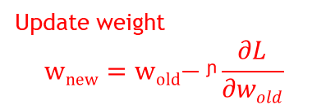
Training of Multi Layer Neural Network
Input Layer
Input the features
f1
Hidden Layer 1
Apply activation function on summation of product of weight and feature.
f11
Hidden Layer 2
f2
f21
Output Layer
Repeat the process in next layer through hidden layers.
f12
f31
Loss = ∑(y-ŷ)²
f3
f22
1X1 Matrix
Compare the output (ŷ) of output layer with expected output (y) to calculate the loss
f13
3X2 Matrix
f4
4X3 Matrix
Loopback and adjust the weight using optimizer for each layer using differential of Loss w.r.t. weight and learning factor.
Update weight
$$wnew=\text{w}\text{old}\text{− }\text{ᶮ}\frac{∂L}{∂wold}$$
Repeat to minimize loss

Slide 10
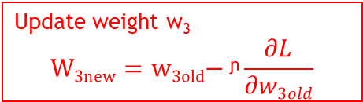
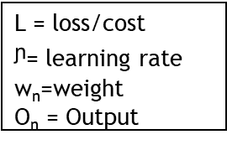
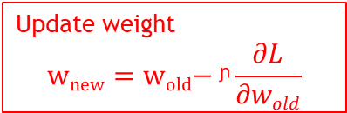
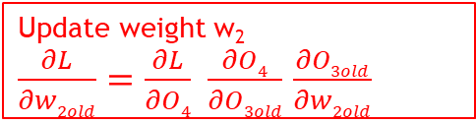
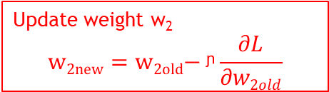
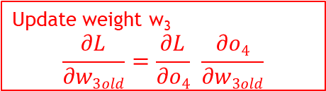
Chain Rule in Back Propagation
Update weight
$$wnew=\text{w}\text{old}\text{− }\text{ᶮ}\frac{∂L}{∂wold}$$
L = loss/cost
$\text{ᶮ}$= learning rate
w_{n}=weight
O_{n} = Output
Update weight w₃
$$W3new=\text{w}\text{3}\text{old}\text{− }\text{ᶮ}\frac{∂L}{∂w3old}$$
w1
w2
w3
L=(y- ŷ)
Update weight w₃
$$\frac{∂L}{∂w3old}=\frac{∂L}{∂o4} \frac{∂o4}{∂w3old}$$
O1
O2
O3
O4(ŷ)
Expected Output (y)
Update weight w₂
$$w2new=\text{w}\text{2}\text{old}\text{− }\text{ᶮ}\frac{∂L}{∂w2old}$$
Same formula and method is used for calculating and adjusting the bias
Update weight w₂
$\frac{∂L}{∂w2old}=\frac{∂L}{∂O4} \frac{∂O4}{∂O3old}$ $\frac{∂O3old}{∂w2old}$

Slide 11
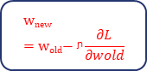
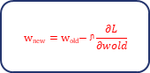
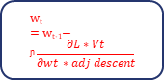
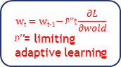
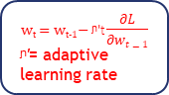
Optimizer
Optimizer are function that calculates the loss and update the weights in backward propagation
Gradient Descent
One Epoch and one iteration (all record in one iteration)
All data forward and backward
SGD: Stochastic Gradient Descent
Each iteration will have one record
One record forward and backward
Mini Batch SGD
Divide the data into batches
That will reduce number iterations per Epoch
Take whole data per iteration
One record per iteration
Batch of records per iteration
Adaptive Gradient Descent
Rate of descent is changing with every Epoch
This is done by changing learning rate as number of Epochs goes up
Adam: Adaptive Momentum Estimator
Momentum (smoothing) + RMS Prop (Learning Rate)
Adjust learning rate to overcome the problem of diminishing gradient by adjusting the denominate of adaptive Gradient descent.
RMS Prop
Most popular and uses mini batch iteration
Use Mini Batch iteration
$$wnew=\text{w}\text{old}\text{− }\text{ᶮ}\frac{∂L}{∂wold}$$
High Resource Intensive
$$wnew=\text{w}\text{old}\text{− }\text{ᶮ}\frac{∂L}{∂wold}$$
Low Resource but Slow
$$wnew=\text{w}\text{old}\text{− }\text{ᶮ}\frac{∂L}{∂wold}$$
Zig-Zag Descent
$$wt=\text{w}\text{t}\text{−1− }\text{ᶮ}\text{′}\text{t}\frac{∂L}{∂wt−1}$$
$\text{ᶮ}\text{′}$= adaptive learning rate
Diminishing Gradient Issue
$$wt=\text{w}\text{t}\text{−1− }\text{ᶮ}\text{′′}\text{t}\frac{∂L}{∂wold}$$
$\text{ᶮ}’\text{′}$= limiting adaptive learning
Overcome Diminishing Gradient Issue
$$wt=\text{w}\text{t}\text{−1− }\text{ᶮ}\frac{∂L∗Vt}{∂wt ∗adj descent}$$
Makes RMS Prop Curve Smooth

Slide 12
Optimizer Curve
Stochastic Gradient Descent
Mini Batch SGD
Gradient Descent
Adaptive Gradient Descent
RMS Prop
Adam

Slide 13
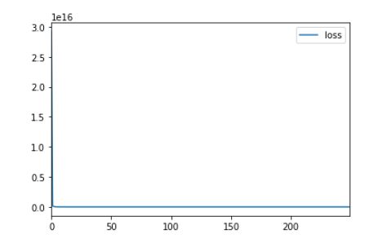
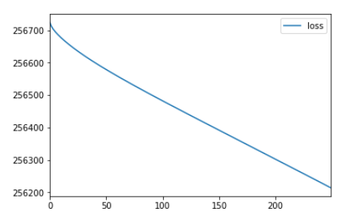
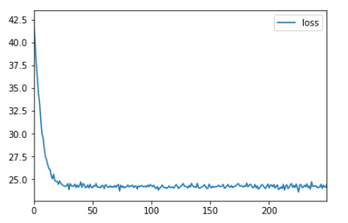
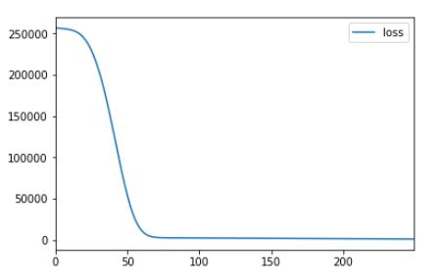
Compare Optimizers
SGD
Adaptive Gradient Descent
Optimizer | Loss
adam | 173.8468
sgd | 8788.1917
rmsprop | 45.3809
adaptive Grad Descent | 256213.7563
RMSProp
adam

